Slide 1
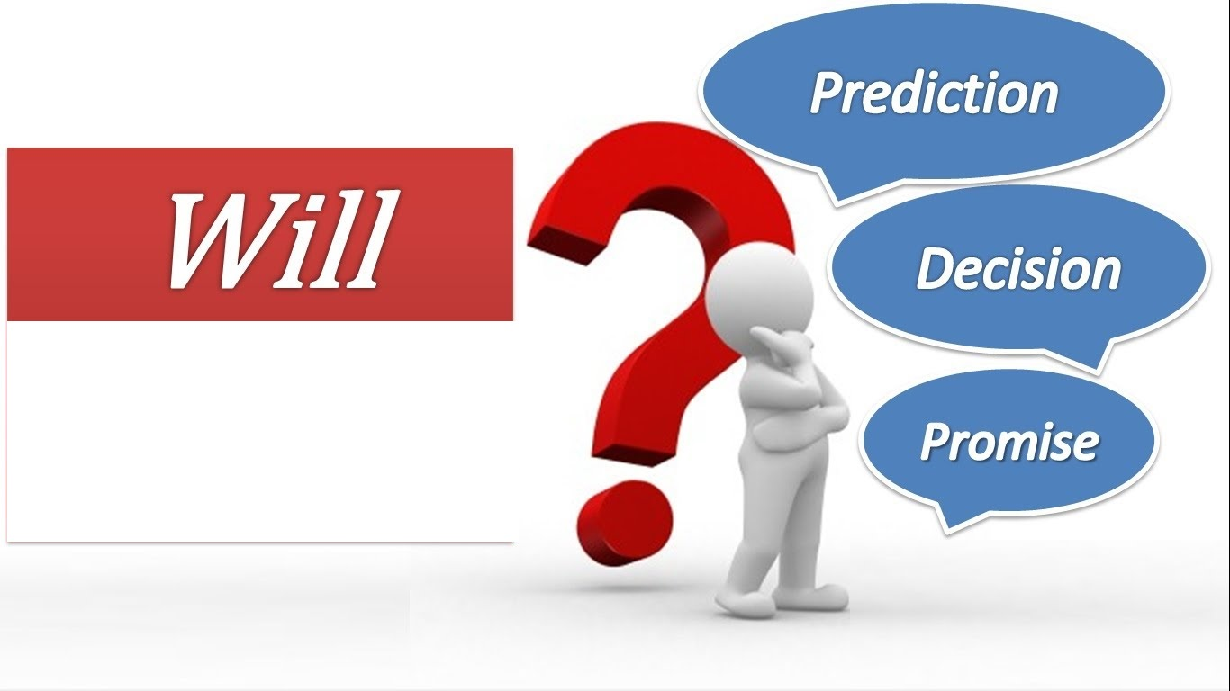
Pripremio Dušan Vukanić, profesor engleskog jezika u JU OŠ "21. maj" Podgorica
7. RAZRED

Slide 2
LINK https://www.youtube.com/watch?v=bdwUJrUNDlo

Slide 3
Promise:
I will love you forever.
Things will mend in the end.
Prediction:
I think it will rain in the evening.
Flowers won’t grow under trees.
Decision:
Will you marry me, please?
What will you say in reply?

Slide 4
Promise:
I will love you ___.
Things will mend in ___ ___.
Prediction:
I think it will ___ in the evening.
Flowers won’t ___ under trees.
Decision:
___ you marry me, please?
___ will you say in reply?

Slide 5
Promise:
I will love ___ ___.
Things will mend ___ ___ ___.
Prediction:
I think it ___ ___ in the evening.
Flowers won’t ___ ___ trees.
Decision:
___ ___ marry me, please?
___ ____ you say in reply?

Slide 6
Promise:
I will ___ ___ ___.
Things ___ mend ___ ___ ___.
Prediction:
I think it ___ ___ ___ ___ ___.
Flowers won’t ___ ___ ___.
Decision:
___ ___ marry me, ___?
___ ___ ___ say in reply?

Slide 7
Promise:
I ___ ___ ___ ___.
Things ___ ___ ___ ___ ___.
Prediction:
I think ___ ___ ___ ___ ___ ____.
Flowers ___ ___ ___ ___.
Decision:
___ ___ marry ___, ___?
___ ___ ___ say ___ ___?

Slide 8

will
We use _________ to talk about predictions , decisions and promises .

Slide 9
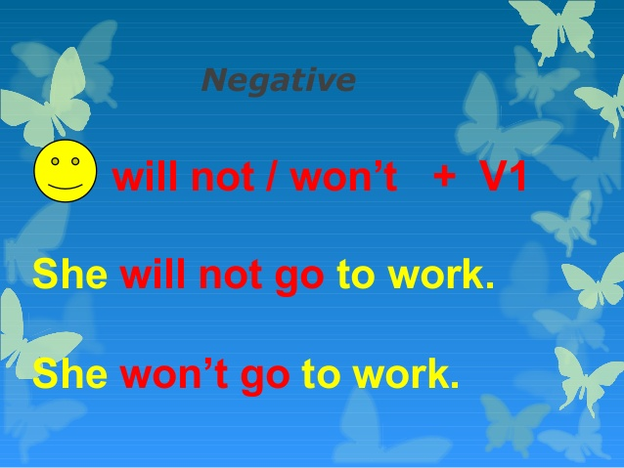

Slide 10
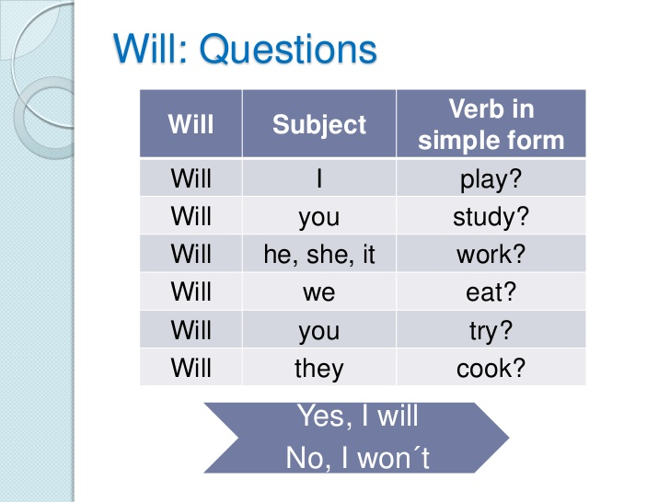

Slide 11

I ______ the best husband in the whole world.
will be
PROMISE

Slide 12

It _______ in the evening.
will rain
PREDICTION

Slide 13
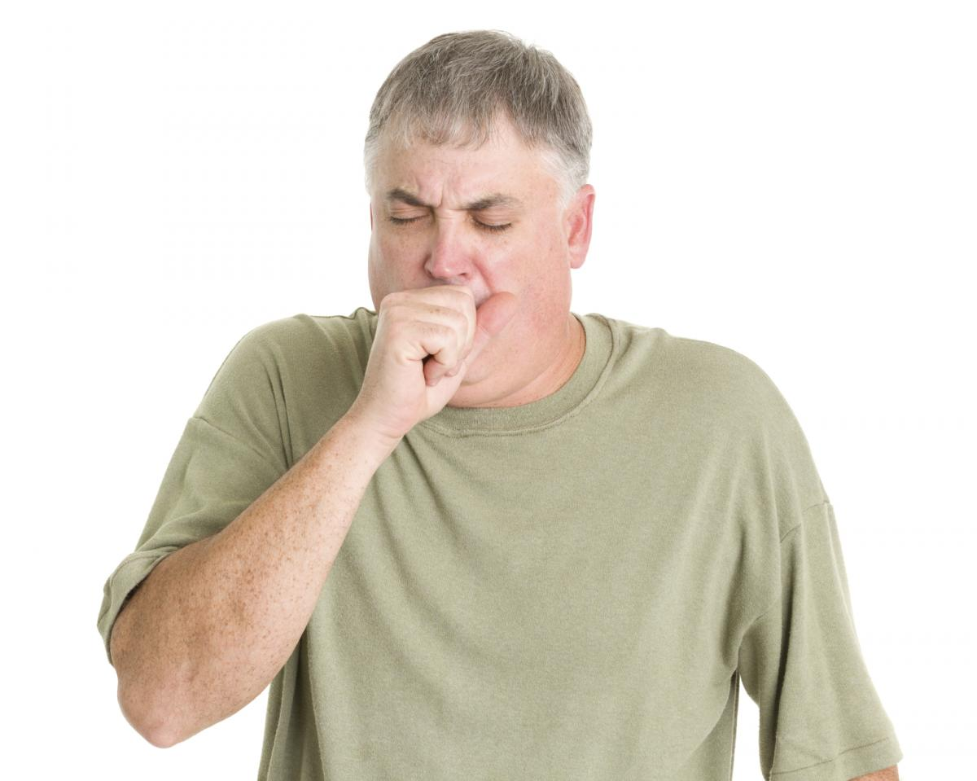
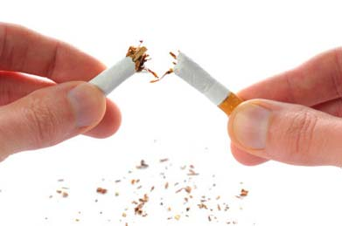
I __________ anymore.
won’t smoke
DECISION

Slide 14
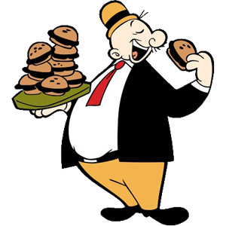
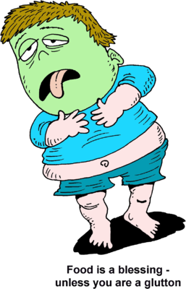
He __________ sick.
I _________ fast food anymore.
will feel
won’t eat

Slide 15
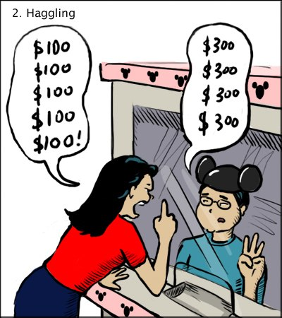
Remember! It’s a secret between us!
I promise I ___________ anyone!
won’t tell

Slide 16
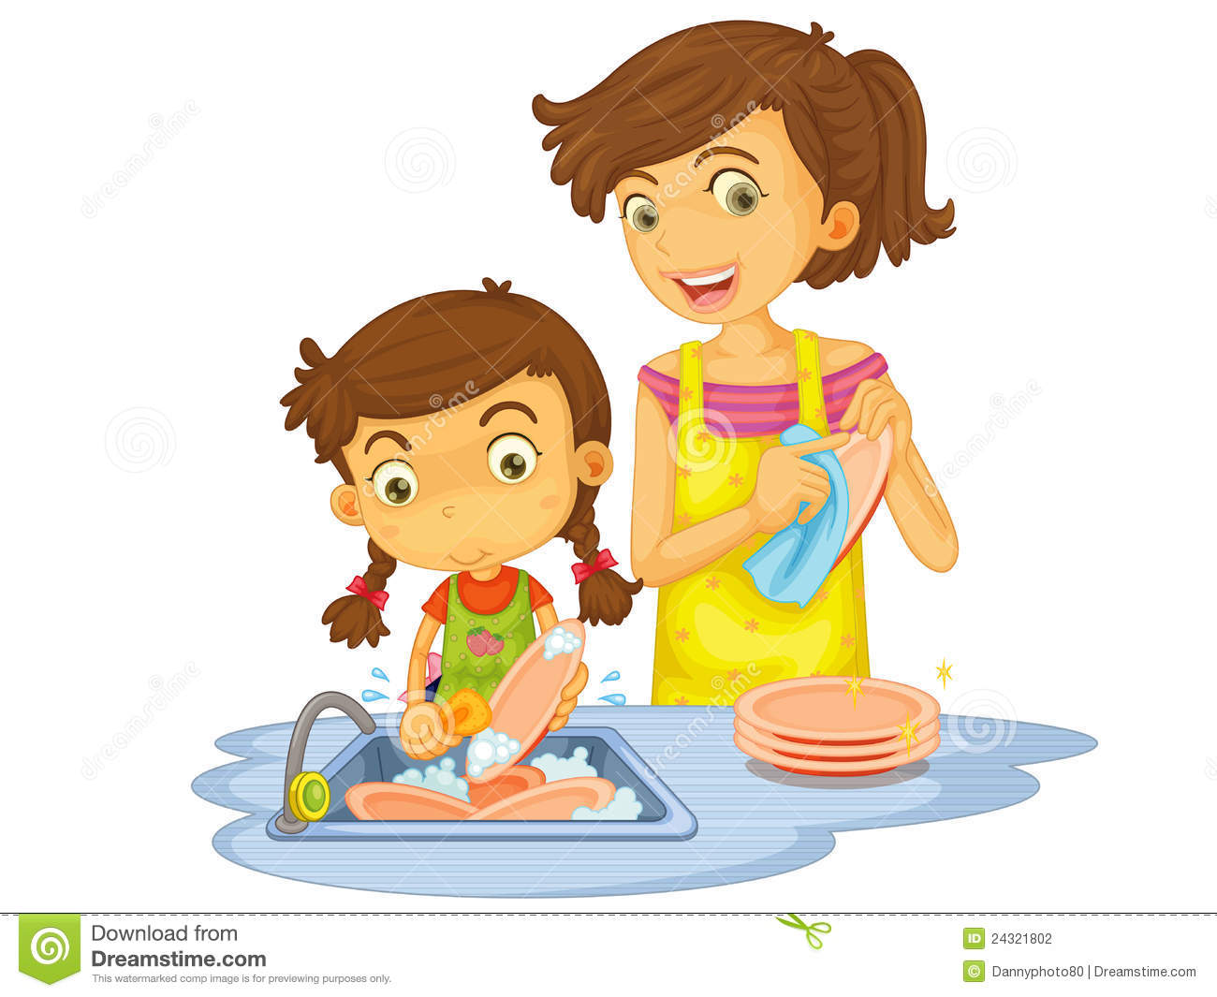
Go and sit down. I ________ the washing up.
‘ll do

Slide 17

It’s my turn. I______ for this.
‘ll pay

Slide 18
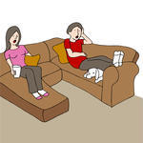

It’s OK. I________ it. I think it’s for me.
‘ll answer

Slide 19
Mike
Will
Won’t
rain
there
tomorrow
You
be
for hours
My brother
stay
at home
next month
John
come
ever
We
smoke
to New Jersey
tonight
I
go
anymore
That girl
call
bedroom
next year
It
clean
today

Slide 20
THE END

