Slide 1
JOBS
I’M A DOCTOR

Slide 2
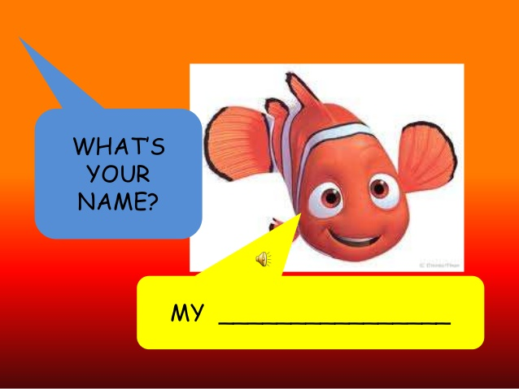

Slide 3
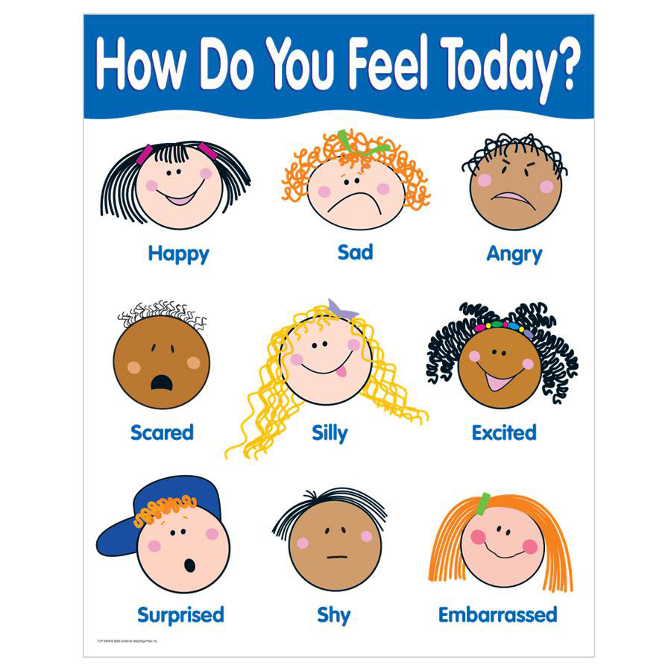

Slide 4


Slide 5
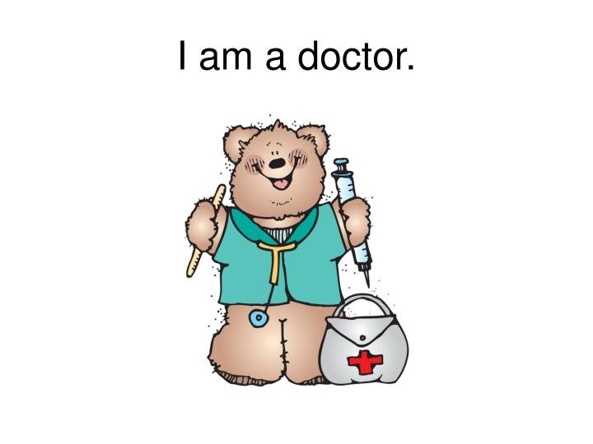

Slide 6
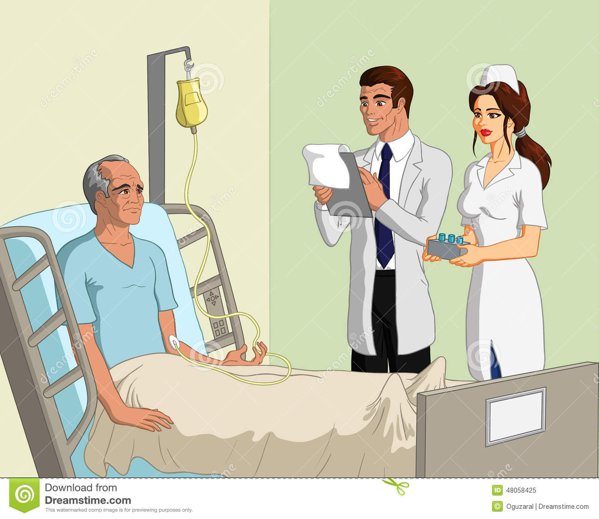
He is a patient.
He is a doctor.
She is a nurse.

Slide 7
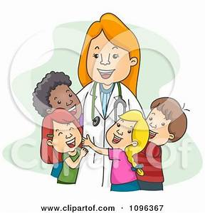
She is a doctor.

Slide 8

He is a doctor.

Slide 9
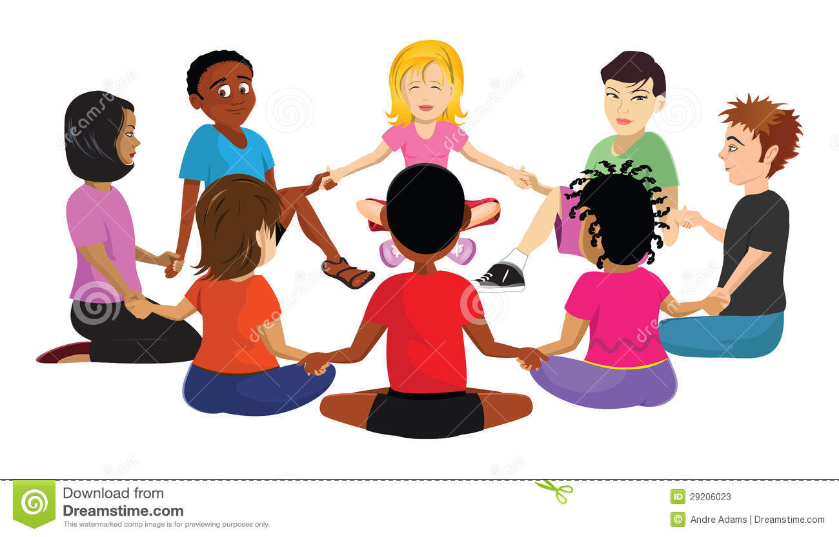
Children sit in a circle. I encourage one of them to go around and say “He is a doctor” or “She is a doctor” whether it is a boy or a girl.

Slide 10
Medical equipment
Doctors use:
Nurses use:

Slide 11


Slide 12


Slide 13


